Slide 2
Shader Model 5.0 and Compute Shader
Nick Thibieroz, AMD

Slide 3
DX11 Basics
New API from Microsoft
Will be released alongside Windows 7
  Runs on Vista as well
Supports downlevel hardware
  DX9, DX10, DX11-class HW supported
  Exposed features depend on GPU
Allows the use of the same API for multiple generations of GPUs
  However Vista/Windows7 required
Lots of new features…

Slide 4
Shader Model 5.0

Slide 5
SM5.0 Basics
All shader types support Shader Model 5.0
  Vertex Shader
  Hull Shader
  Domain Shader
  Geometry Shader
  Pixel Shader
Some instructions/declarations/system values are shader-specific
Pull Model
Shader subroutines

Slide 6
Uniform Indexing
Can now index resource inputs
  Buffer and Texture resources
  Constant buffers
  Texture samplers
Indexing occurs on the slot number
  E.g. Indexing of multiple texture arrays
  E.g. indexing across constant buffer slots
Index must be a constant expression
Texture2D txDiffuse[2] : register(t0);
Texture2D txDiffuse1 : register(t1);
static uint Indices[4] = { 4, 3, 2, 1 };
float4 PS(PS_INPUT i) : SV_Target
{
float4 color=txDiffuse[Indices[3]].Sample(sam, i.Tex);
// float4 color=txDiffuse1.Sample(sam, i.Tex);
}

Slide 7
SV_Coverage
System value available to PS stage only
Bit field indicating the samples covered by the current primitive
  E.g. a value of 0x09 (1001b) indicates that sample 0 and 3 are covered by the primitive
Easy way to detect MSAA edges for per-pixel/per-sample processing optimizations
  E.g. for MSAA 4x:
  bIsEdge=(uCovMask!=0x0F && uCovMask!=0);

Slide 8
Double Precision
Double precision optionally supported
  IEEE 754 format with full precision (0.5 ULP)
  Mostly used for applications requiring a high amount of precision
  Denormalized values support
Slower performance than single precision!
Check for support:
D3D11_FEATURE_DATA_DOUBLES fdDoubleSupport;
pDev->CheckFeatureSupport( D3D11_FEATURE_DOUBLES,
&fdDoubleSupport,
sizeof(fdDoubleSupport) );
if (fdDoubleSupport.DoublePrecisionFloatShaderOps)
{
// Double precision floating-point supported!
}

Slide 9
Gather()
Fetches 4 point-sampled values in a single texture instruction
Allows reduction of texture processing
  Better/faster shadow kernels
  Optimized SSAO implementations
SM 5.0 Gather() more flexible
  Channel selection now supported
  Offset support (-32..31 range) for Texture2D
  Depth compare version e.g. for shadow mapping
  Gather[Cmp]Red()
  Gather[Cmp]Green()
  Gather[Cmp]Blue()
  Gather[Cmp]Alpha()
W
Z
X
Y

Slide 10
Coarse Partial Derivatives
ddx()/ddy() supplemented by coarse version
  ddx_coarse()
  ddy_coarse()
Return same derivatives for whole 2x2 quad
  Actual derivatives used are IHV-specific
Faster than “fine” version
  Trading quality for performance
ddx_coarse( ) ==
ddx_coarse( ) ==
ddx_coarse( ) ==
ddx_coarse( )
Same principle applies to ddy_coarse()

Slide 11
Other Instructions
FP32 to/from FP16 conversion
  uint f32tof16(float value);
  float f16tof32(uint value);
  fp16 stored in low 16 bits of uint
Bit manipulation
  Returns the first occurrence of a set bit
    int firstbithigh(int value);
    int firstbitlow(int value);
  Reverse bit ordering
    uint reversebits(uint value);
  Useful for packing/compression code
  And more…

Slide 12
Unordered Access Views
New view available in Shader Model 5.0
UAVs allow binding of resources for arbitrary (unordered) read or write operations
  Supported in PS 5.0 and CS 5.0
Applications
  Scatter operations
  Order-Independent Transparency
  Data binning operations
Pixel Shader limited to 8 RTVs+UAVs total
  OMSetRenderTargetsAndUnorderedAccessViews()
Compute Shader limited to 8 UAVs
  CSSetUnorderedAccessViews()

Slide 13
Raw Buffer Views
New Buffer and View creation flag in SM 5.0
  Allows a buffer to be viewed as array of typeless 32-bit aligned values
    Exception: Structured Buffers
  Buffer must be created with flag D3D11_RESOURCE_MISC_BUFFER_ALLOW_RAW_VIEWS
  Can be bound as SRV or UAV
    SRV: need D3D11_BUFFEREX_SRV_FLAG_RAW flag
    UAV: need D3D11_BUFFER_UAV_FLAG_RAW flag
ByteAddressBuffer MyInputRawBuffer; // SRV
RWByteAddressBuffer MyOutputRawBuffer; // UAV
float4 MyPS(PSINPUT input) : COLOR
{
uint u32BitData;
u32BitData = MyInputRawBuffer.Load(input.index);// Read from SRV
MyOutputRawBuffer.Store(input.index, u32BitData);// Write to UAV
// Rest of code ...
}

Slide 14
Structured Buffers
New Buffer creation flag in SM 5.0
  Ability to read or write a data structure at a specified index in a Buffer
  Resource must be created with flag D3D11_RESOURCE_MISC_BUFFER_STRUCTURED
  Can be bound as SRV or UAV
struct MyStruct
{
float4 vValue1;
uint uBitField;
};
StructuredBuffer<MyStruct> MyInputBuffer; // SRV
RWStructuredBuffer<MyStruct> MyOutputBuffer; // UAV
float4 MyPS(PSINPUT input) : COLOR
{
MyStruct StructElement;
StructElement = MyInputBuffer[input.index]; // Read from SRV
MyOutputBuffer[input.index] = StructElement; // Write to UAV
// Rest of code ...
}

Slide 15
Buffer Append/Consume
Append Buffer allows new data to be written at the end of the buffer
  Raw and Structured Buffers only
  Useful for building lists, stacks, etc.
Declaration
    Append[ByteAddress/Structured]Buffer MyAppendBuf;
Access to write counter (Raw Buffer only)
    uint uCounter = MyRawAppendBuf.IncrementCounter();
Append data to buffer
    MyRawAppendBuf.Store(uWriteCounter, value);
    MyStructuredAppendBuf.Append(StructElement);
Can specify counters’ start offset
Similar API for Consume and reading back a buffer

Slide 16
Atomic Operations
PS and CS support atomic operations
  Can be used when multiple threads try to modify the same data location (UAV or TLS)
  Avoid contention
  InterlockedAdd
  InterlockedAnd/InterlockedOr/InterlockedXor
  InterlockedCompareExchange
  InterlockedCompareStore
  InterlockedExchange
  InterlockedMax/InterlockedMin
Can optionally return original value
Potential cost in performance
  Especially if original value is required
  More latency hiding required

Slide 17
Compute Shader

Slide 18
Compute Shader Intro
A new programmable shader stage in DX11
  Independent of the graphic pipeline
New industry standard for GPGPU applications
CS enables general processing operations
  Post-processing
  Video filtering
  Sorting/Binning
  Setting up resources for rendering
  Etc.
Not limited to graphic applications
  E.g. AI, pathfinding, physics, compression…

Slide 19
CS 5.0 Features
Supports Shader Model 5.0 instructions
Texture sampling and filtering instructions
  Explicit derivatives required
Execution not limited to fixed input/output
Thread model execution
  Full control on the number of times the CS runs
Read/write access to “on-cache” memory
  Thread Local Storage (TLS)
  Shared between threads
  Synchronization support
Random access writes
  At last! ☺ Enables new possibilities (scattering)

Slide 20

CS Threads
A thread is the basic CS processing element
CS declares the number of threads to operate on (the “thread group”)
  [numthreads(X, Y, Z)]
  void MyCS(…)
To kick off CS execution:
  pDev11->Dispatch( nX, nY, nZ );
  nX, nY, nZ: number of thread groups to execute
Number of thread groups can be written out to a Buffer as pre-pass
  pDev11->DispatchIndirect(LPRESOURCE *hBGroupDimensions, DWORD dwOffsetBytes);
  Useful for conditional execution
CS 5.0
X*Y*Z<=1024
Z<=64

Slide 21
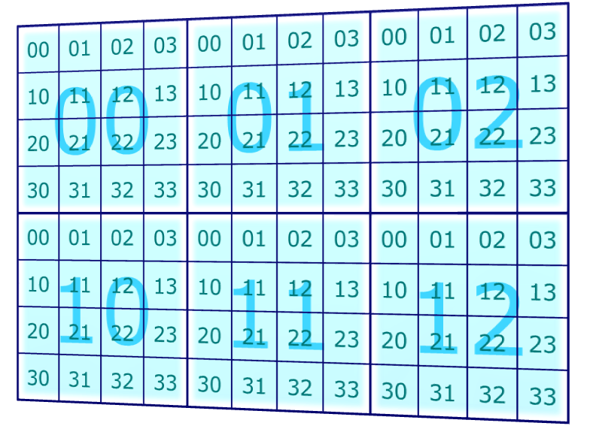
CS Threads & Groups
  pDev11->Dispatch(3, 2, 1);
  [numthreads(4, 4, 1)]
  void MyCS(…)
  Total threads = 3*2*4*4 = 96

Slide 22
CS Parameter Inputs
  pDev11->Dispatch(nX, nY, nZ);
  [numthreads(X, Y, Z)]
  void MyCS(
  uint3 groupID: SV_GroupID,
  uint3 groupThreadID: SV_GroupThreadID,
  uint3 dispatchThreadID: SV_DispatchThreadID,
  uint groupIndex: SV_GroupIndex);
groupID.xyz: group offsets from Dispatch()
  groupID.xyz є (0..nX-1, 0..nY-1, 0..nZ-1);
  Constant within a CS thread group invocation
groupThreadID.xyz: thread ID in group
  groupThreadID.xyz є (0..X-1, 0..Y-1, 0..Z-1);
  Independent of Dispatch() parameters
dispatchThreadID.xyz: global thread offset
  = groupID.xyz*(X,Y,Z) + groupThreadID.xyz
groupIndex: flattened version of groupThreadID

Slide 23
CS Bandwidth Advantage
Memory bandwidth often still a bottleneck
  Post-processing, compression, etc.
Fullscreen filters often require input pixels to be fetched multiple times!
  Depth of Field, SSAO, Blur, etc.
  BW usage depends on TEX cache and kernel size
TLS allows reduction in BW requirements
Typical usage model
  Each thread reads data from input resource
  …and write it into TLS group data
  Synchronize threads
  Read back and process TLS group data

Slide 24
Thread Local Storage
Shared between threads
Read/write access at any location
Declared in the shader
  groupshared float4 vCacheMemory[1024];
Limited to 32 KB
Need synchronization before reading back data written by other threads
  To ensure all threads have finished writing
  GroupMemoryBarrier();
  GroupMemoryBarrierWithGroupSync();

Slide 25
CS 4.X
Compute Shader supported on DX10(.1) HW
  CS 4.0 on DX10 HW, CS 4.1 on DX10.1 HW
Useful for prototyping CS on HW device before DX11 GPUs become available
Drivers available from ATI and NVIDIA
Major differences compared to CS5.0
  Max number of threads is 768 total
  Dispatch Zn==1 & no DispatchIndirect() support
  TLS size is 16 KB
  Thread can only write to its own offset in TLS
  Atomic operations not supported
  Only one UAV can be bound
  Only writable resource is Buffer type

Slide 26
PS 5.0 vs CS 5.0 Example: Gaussian Blur
Comparison between a PS 5.0 and CS5.0 implementation of Gaussian Blur
Two-pass Gaussian Blur
  High cost in texture instructions and bandwidth
Can the compute shader perform better?

Slide 27
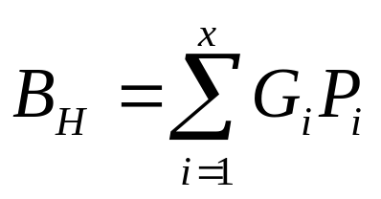
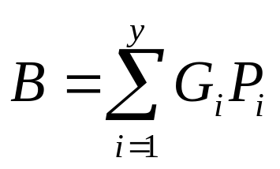
Gaussian Blur PS
Separable filter Horizontal/Vertical pass
  Using kernel size of x*y
For each pixel of each line:
  Fetch x texels in a horizontal segment
  Write H-blurred output pixel in RT:
For each pixel of each column:
  Fetch y texels in a vertical segment from RT
  Write fully blurred output pixel:
Problems:
  Texels of source texture are read multiple times
  This will lead to cache trashing if kernel is large
  Also leads to many texture instructions used!

Slide 28
Gaussian Blur PS
Horizontal Pass
Source texture
Temp RT

Slide 29
Gaussian Blur PS
Vertical Pass
Source texture (temp RT)
Destination RT

Slide 30

Gaussian Blur CS – HP(1)
groupshared float4 HorizontalLine[WIDTH]; // TLS
Texture2D txInput; // Input texture to read from
RWTexture2D<float4> OutputTexture; // Tmp output
[numthreads(WIDTH,1,1)]
void GausBlurHoriz(uint3 groupID: SV_GroupID,
uint3 groupThreadID: SV_GroupThreadID)
{
// Fetch color from input texture
float4 vColor=txInput[int2(groupThreadID.x,groupID.y)];
// Store it into TLS
HorizontalLine[groupThreadID.x]=vColor;
// Synchronize threads GroupMemoryBarrierWithGroupSync();
// Continued on next slide
  pDevContext->Dispatch(1,HEIGHT,1);
[numthreads(WIDTH,1,1)]
Dispatch(1,HEIGHT,1);

Slide 31
Gaussian Blur CS – HP(2)
// Compute horizontal Gaussian blur for each pixel vColor = float4(0,0,0,0);
[unroll]for (int i=-GS2; i<=GS2; i++)
{
// Determine offset of pixel to fetch
int nOffset = groupThreadID.x + i;
// Clamp offset
nOffset = clamp(nOffset, 0, WIDTH-1);
// Add color for pixels within horizontal filter
vColor += G[GS2+i] * HorizontalLine[nOffset];
}
// Store result OutputTexture[int2(groupThreadID.x,groupID.y)]=vColor;
}

Slide 32
Gaussian Blur BW:PS vs CS
Pixel Shader
  # of reads per source pixel: 7 (H) + 7 (V) = 14
  # of writes per source pixel: 1 (H) + 1 (V) = 2
  Total number of memory operations per pixel: 16
  For a 1024x1024 RGBA8 source texture this is 64 MBytes worth of data transfer
    Texture cache will reduce this number
    But become less effective as the kernel gets larger
Compute Shader
  # of reads per source pixel: 1 (H) + 1 (V) = 2
  # of writes per source pixel: 1 (H) + 1 (V) = 2
  Total number of memory operations per pixel: 4
  For a 1024x1024 RGBA8 source texture this is 16 MBytes worth of data transfer

Slide 33
Conclusion
New Shader Model 5.0 feature set extensively powerful
  New instructions
  Double precision support
  Scattering support through UAVs
Compute Shader
  No longer limited to graphic applications
  TLS memory allows considerable performance savings
DX11 SDK available for prototyping
  Ask your IHV for a CS4.X-enabled driver
  REF driver for full SM 5.0 support

Slide 34
Questions?
nicolas.thibieroz@amd.com

